Slide 1
Honors Biology
An Introduction to Biology

Slide 2
Scientific Investigation
The Scientific Method involves a series of steps that are used to investigate a natural occurrence.
Problem/Question
Observation/Research
Formulate a Hypothesis
Experiment
Collect and Analyze Results
Conclusion
Communicate the Results

Slide 3
Problem/Question
Develop a question or problem that can be solved through experimentation.
How does a affect b ?

Slide 4
Observation/Research
Make observations and research your topic of interest.

Slide 5
Formulate a Hypothesis
Predict a possible answer to the problem or question.
The hypothesis is an educated idea about the relationship between the independent and dependent variables.
If-then format
Example: If soil temperatures rise, then plant growth will increase.

Slide 6
Independent Variable
The independent, or manipulated variable, is a factor that is intentionally varied by the experimenter.
Using the sample hypothesis, you would choose the soil temperatures at which you plan to grow the plants.

Slide 7
Dependent Variable
The dependent, or responding variable, is the factor that may change as a result of changes made in the independent variable.
In our example, you just need to decide how you will measure plant growth– height of plant, mass of plant, number of leaves, etc.

Slide 8
Experiment
Develop and follow a procedure.
Include a detailed materials list.
The outcome must be measurable (quantifiable).

Slide 9
Control Group
The control group is exposed to the same conditions as the experimental group, except for the variable being tested.
All experiments should have a control group.

Slide 10
Constants
The constants in an experiment are all the factors that the experimenter attempts to keep the same.
Also called controlled variables.

Slide 11
Trials
Trials refer to replicate groups that are exposed to the same conditions in an experiment.
The more trials you have, the more confident you can be in the outcome.

Slide 12
Collect and Analyze Results
Raw data can be transformed (changed) to highlight important trends.
Common transformations include tallies, percentages, and rates.
Modify the procedure if needed.
Confirm the results by retesting.
Include tables, graphs, and photographs.

Slide 13
Conclusion
Include a statement that accepts or rejects the hypothesis.
Make recommendations for further study and possible improvements to the procedure.

Slide 14
Communicate the Results
Be prepared to present the project to an audience.
Expect questions from the audience.
Communication can be oral, written, or a combination of both.
Communication should be suited to the desired audience.

Slide 15
Biological Drawings
Biological drawings record what a specimen looks like and records its most important features.
Biological drawing record what is actually seen.
They can focus on only those structures under current investigation.

Slide 16
Cell Theory
The Cell Theory is a cornerstone of modern biology.
All living organisms are composed of one or more cells.
Cells are the basic units of structure and organization in living things.
All cells come from existing cells.

Slide 17
Two Types of Cells
Prokaryotic Cells (Prokaryotes)
pro: before; karyon: kernel/nucleus
Bacterial cells
Do not have a membrane-bound nucleus or any other membrane bound organelles
Small, single cells (unicellular), 0.5-10 μm
Very little internal cellular organization
Peptidoglycan cell wall surrounds cell membrane

Slide 18
Eukaryotic Cells (Eukaryotes)
Eu: true (true nucleus)
Membrane-bound nucleus, other membrane-bound organelles
Large, unicellular or multicellular, 30-150 μm
More complex, more internal cellular structure and organization
If cell wall is present, it is made of cellulose

Slide 19
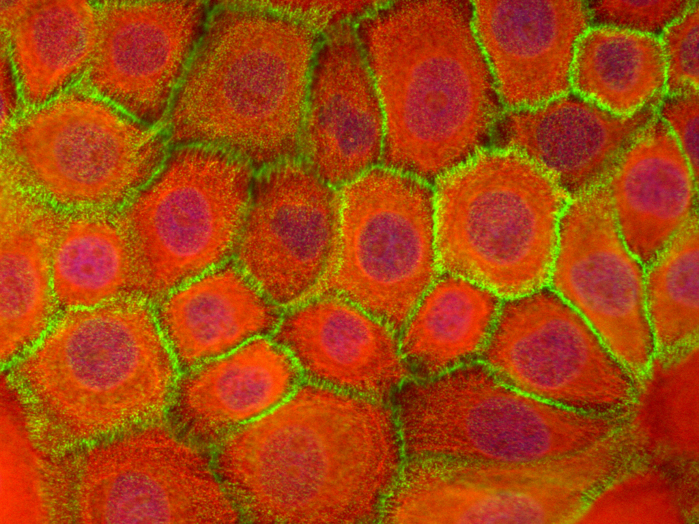
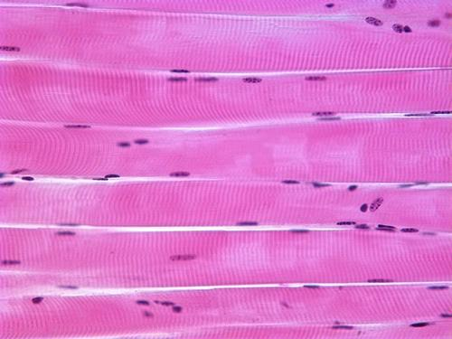
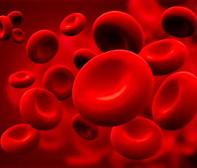
Organelles are specialized structures within eukaryotic cells that carry out specialized functions for the cell.
In multicellular organisms, cells are also specialized to carry out specific roles.
Skin (epithelial) cells
Muscle cells
Red blood cells

Slide 20
Multicellular Organisms
Hierarchical Organization:
Cells
Tissues
Organs
Organ Systems
Organism

Slide 21
Evolution
The Theory of Evolution is a cornerstone of modern biology.
Evolution: A cumulative change in the inherited characteristics of a population over time.
Natural Selection: Organisms that are better suited to their environment are more likely to survive and produce offspring.

Slide 22
Evidence for Evolution
Evidence for evolution comes from a vast collection of observations made by many scientists in many places over many years.

Slide 23
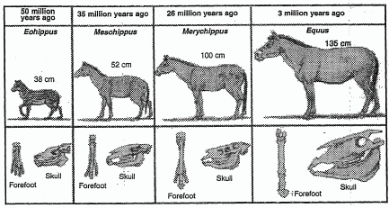
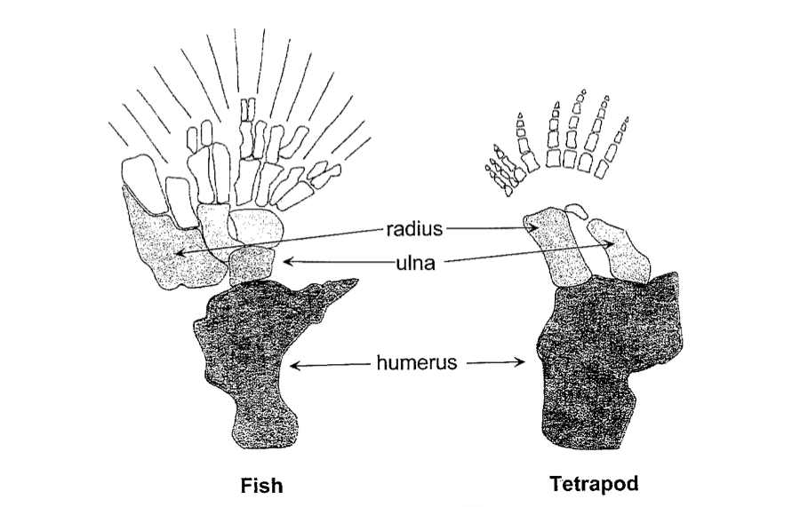
Types of Evidence:
Fossil record
Homologous structures
Embryology

