Slide 1
Biochemistry
The Building Blocks of Life

Slide 2
Atoms, Molecules, & Ions
Atoms: Basic building blocks of all matter
Most common elements present in living things are carbon, hydrogen, oxygen, nitrogen, phosphorus, and sulfur
Remember:
Ions: Atoms or groups of atoms having a positive or negative charge.
Positive ions are atoms that have given up electrons
Negative ions are atoms that have gained electrons

Slide 3
Atoms, Molecules, & Ions
Molecules: made of 2 or more atoms, bonded together
Covalent bonds:
Ionic bonds:

Slide 4
Covalent Bonding
Carbon has four electrons in its outer shell. Hydrogen has one electron.
One covalent bond consists of two electrons being shared by two atoms.

Slide 5
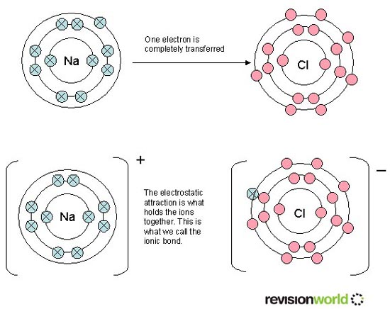
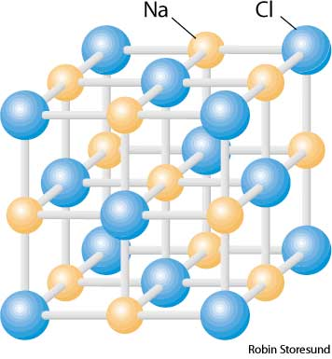
Ionic Bonding
Ions form when atoms gain or lose electrons.
Oppositely charged ions attract each other.

Slide 6
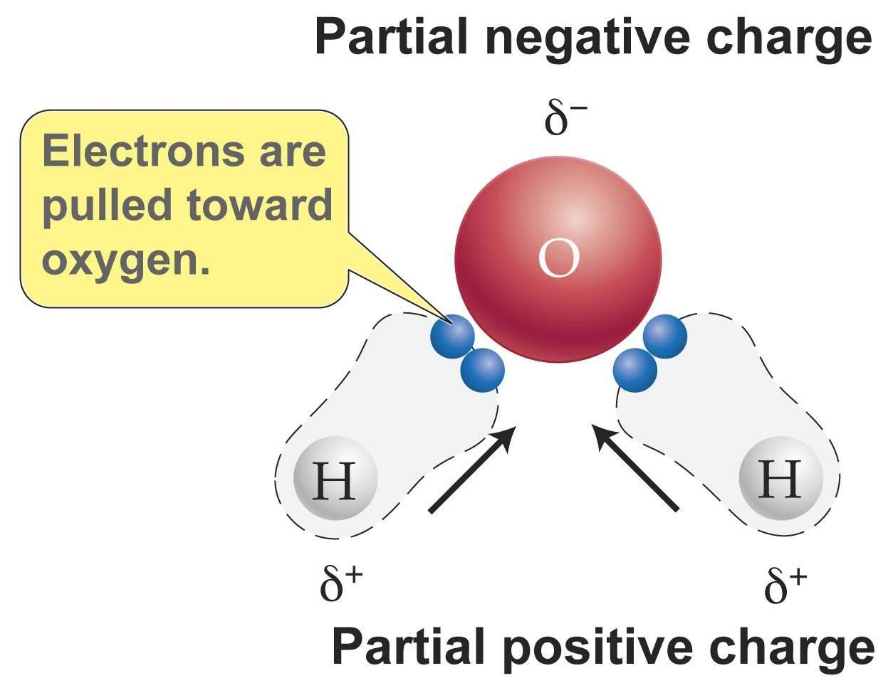
Water, H₂O
The bond between hydrogen and oxygen is called a polar covalent bond.
Although the electrons are shared, they are not shared equally between the two atoms.

Slide 7
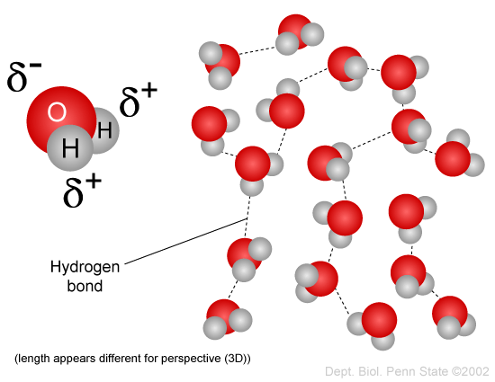
Water, H₂O
The slightly positive regions (H sides) have a weak attraction to the slightly negative regions (O side) of adjacent water molecules.

Slide 8
Water, H₂O
These weak attractions are called hydrogen bonds, although technically, they are not bonds.
The water molecule has special properties due to these hydrogen bonds.
Although we are familiar with the behavior of water, other molecules of similar size behave quite differently.

Slide 9
Special Properties of Water
Temperature Stabilizing Effect
A large amount of energy is needed to change the temperature of water.
A large amount of energy is needed to change water from one state to another.
Because so much of the Earth is covered in water, this property keeps the Earth within a temperature range that is suitable for life.
Ice acts as an insulator, so lakes don’t freeze all the way to the bottom.

Slide 10
Special Properties of Water
Cohesion
Water molecules hold together.
Creates surface tension, allowing small objects (or insects) to float on water.
Allows narrow columns of water to move up a tree for several hundred meters.
Good Solvent
Because water is a good solvent, many of the other molecules needed for life can dissolve in it.

Slide 11
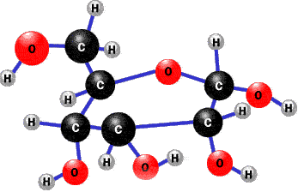
Carbon Compounds
Organic chemistry – the study of compounds that contain bonds between carbon atoms

Slide 12
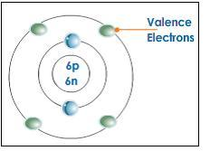
The Chemistry of Carbon
Why is carbon special?
It has 4 valence (outer) electrons to form strong covalent bonds
Can bond with many elements and itself, including H, O. P, S, and N
Can form chains and rings to create large complex structures

Slide 13
Macromolecules
Means
Built by a process called polymerization
Monomers – smaller units of macromolecules
Polymers – a macromolecule (made of monomers that are similar or different)
4 major groups:

Slide 14
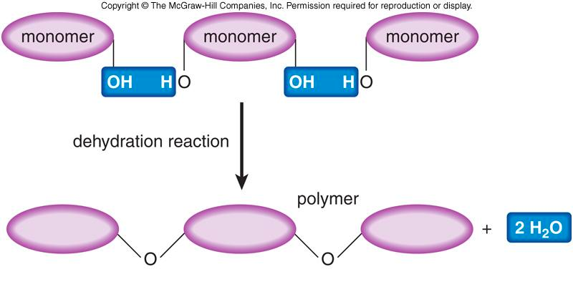
Dehydration Synthesis
A water molecule is released for each bond that it formed.
Monomers link together to form polymers.

Slide 15
Hydrolysis
Polymers are broken down into monomers.
For each bond broken, one water molecule is used.

Slide 16
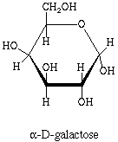
Carbohydrates
Compounds made up of carbon, hydrogen and oxygen, usually in a 1:2:1 ratio
Primary energy source
Also used for structural purposes

Slide 17
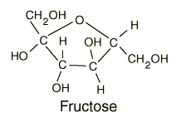
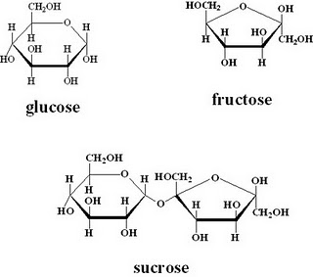
Carbohydrates
Simple Sugars
Monosaccharide – simple sugars, this is the carbohydrate monomer
Ex: Glucose, Galactose, and Fructose
Disaccharides – two simple sugars joined together
Ex: table sugar is made of glucose and fructose

Slide 18
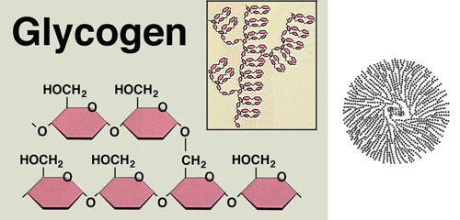
Carbohydrates
Complex Carbohydrates
Large molecules formed from monosaccharides
Ex: Glycogen “animal starch” store of excess sugar for muscle contraction
Ex: Starch (stores excess sugar) and Cellulose (for strength)

Slide 19
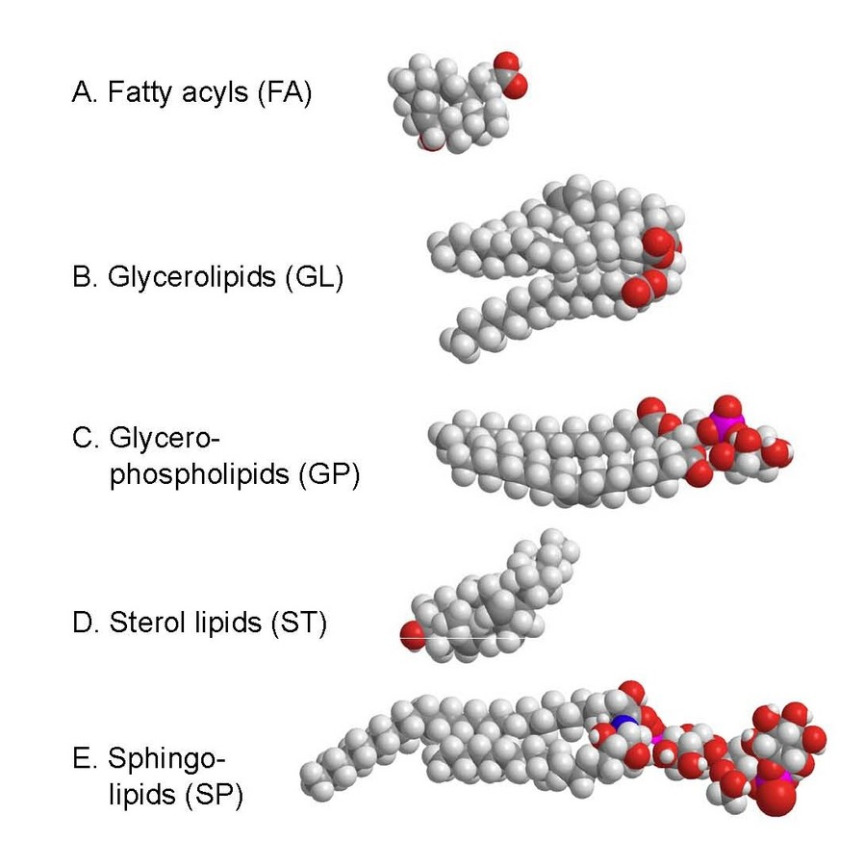
Lipids
Made mostly of carbon and hydrogen
Many different kinds
Not soluble in water
Used as a secondary energy source
Used in biological membranes and waterproof coverings
Some are used as chemical messengers (ex. Steroids, hormones)

Slide 20
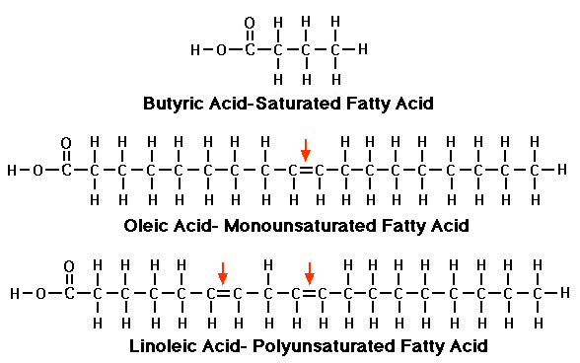
Lipids
Monomer
Glycerol
Fatty Acids
Saturated – No carbon double bonds, saturated with hydrogen in fatty acid
Unsaturated – At least one carbon double bond in fatty acid (liquid at room temperature)
Polyunsaturated – More than one carbon double bond in fatty acid (liquid at room temperature)

Slide 21
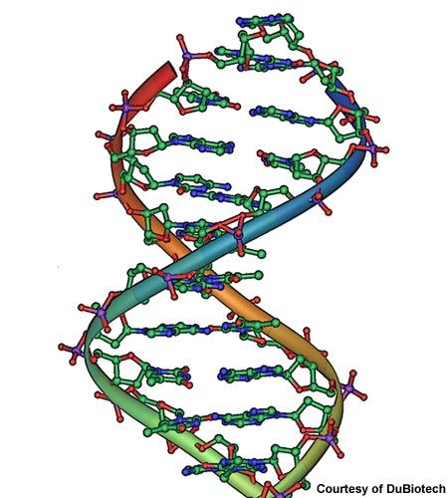
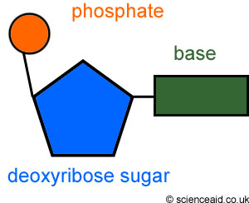
Nucleic Acids
Macromolecules containing hydrogen, oxygen, nitrogen, carbon and phosphorus
Monomer – Nucleotides, which consists of three parts: a 5-carbon sugar, a phosphate group, and a nitrogen base
Used to store and transmit genetic information
Used to capture and transfer chemical energy short term
Two types: DNA and RNA

Slide 22
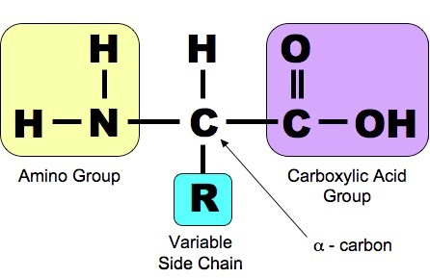
Protein
Macromolecules that contain nitrogen, carbon, hydrogen and oxygen
Monomers – amino acids
Made of an amino group (NH₂) on one end and a carboxyl group (COOH) on the other
More than 20 are found in nature
Differ in the R-group which gives each amino acid different properties
Form covalent, ionic, hydrogen bonds with one another, as well as use van der waals forces to create their unique structure of fold

Slide 23
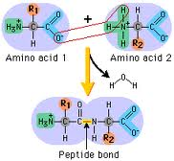
Protein
Peptide bonds – are covalent bonds that link amino acids together by dehydration synthesis
Used to control the rate of reactions and regulate cell processes
Used to form cell structures
Used to transmit substances into and out of cells
Used to help fight diseases

Slide 24
Enzymes
Enzymes are proteins that speed up the rate at which reactions approach equilibrium.

Slide 25
Enzymes

Slide 27
Induced Fit Model

Slide 28
Factors Affecting Enzymes
Enzymes, being proteins, tend to work only in specific conditions.
Temperature:

Slide 29
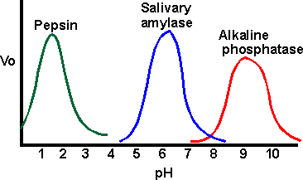
pH
The pH range depends on the particular activity of the enzyme.

